Slide 1

Array and Linked List based Queue
Data Structure | ADT: Stack and Queue
Course: Data Structure | Chapter: ADT: Stack and Queue | Program: Bachelor of Engineering
DISCOVER · LEARN · EMPOWER
Notes:
Welcome everyone to today's lecture on Data Structures. We are focusing specifically on the Abstract Data Type of Queues. Today we will explore how to implement these queues using two fundamental data structures: arrays and linked lists. Remember, mastering these implementations is key to solving real-world scheduling problems.

Slide 2
Course Outcomes
SLIDE 2 / 10
Course Outcome
CO | BT LEVEL | DESCRIPTION
CO1 | BT1 | Understand and apply basic data structures, algorithms, complexity analysis, ADTs, arrays and linked lists.
CO2 | BT2 | Apply and implement stacks and queues in problem-solving.
CO3 | BT3 | Analyse and apply searching, sorting, and hashing techniques.
CO4 | BT4 | Construct and apply tree structures and traversal techniques.
CO5 | BT5 | Represent and solve graph problems using DFS, BFS, and graph algorithms.
Chandigarh University
2 / 10
Notes:
This lecture aligns with our broader course outcomes regarding data structures. While we focus on queues today, the logical thinking required here supports CO4 and CO5. Understanding linear structures like queues is a prerequisite for handling complex tree and graph traversals later in the course. These outcomes ensure you can build and apply these structures effectively.

Slide 3
Learning Objectives
SLIDE 3 / 10
Learning Outcomes
1
Define the fundamental operations of a Queue Abstract Data Type.
2
Analyze the implementation of queues using fixed-size arrays.
3
Evaluate the limitations of array-based queue implementations.
4
Compare the dynamic nature of linked list queue implementations.
5
Apply queue operations to solve basic scheduling scenarios.
Chandigarh University
3 / 10
Notes:
By the end of this session, you will be able to define queue operations clearly. You will analyze how arrays handle queue data and identify their specific limitations. We will also evaluate how linked lists solve these space issues. Finally, you will apply these concepts to practical scheduling scenarios.

Slide 4
Lecture
SLIDE 4 / 10
Queue Definition and Operations
1
A Queue is a linear structure following the First-In-First-Out (FIFO) principle.
2
Enqueue adds an element to the rear end of the queue.
3
Dequeue removes an element from the front end of the queue.
4
Front operation retrieves the element at the front without removal.
5
Rear operation retrieves the element at the rear without removal.
Chandigarh University
4 / 10
Notes:
Think of a queue like a line of people waiting for a bus. The person who arrives first is the first to board, which is the FIFO principle. Enqueue is like joining the back of the line, while dequeue is the person at the front leaving. These four operations form the core interface for any queue implementation.

Slide 5
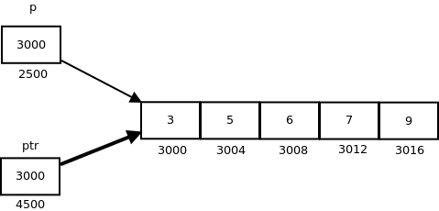
Lecture
SLIDE 5 / 10
Array-Based Queue Implementation
1
An array-based queue uses a fixed-size array to store elements sequentially.
2
Two pointers, 'front' and 'rear', track the start and end positions.
3
Enqueue increments the rear index and places the new element.
4
Dequeue increments the front index to remove the oldest element.
5
The queue is empty when front equals rear plus one.
Source: media.geeksforgeeks.org
Chandigarh University
5 / 10
Notes:
In an array implementation, we allocate a fixed block of memory. We use two indices to manage the queue boundaries. When we add an item, we move the rear pointer forward. When we remove an item, we move the front pointer forward. This simple logic works well until we hit the size limit.

Slide 6
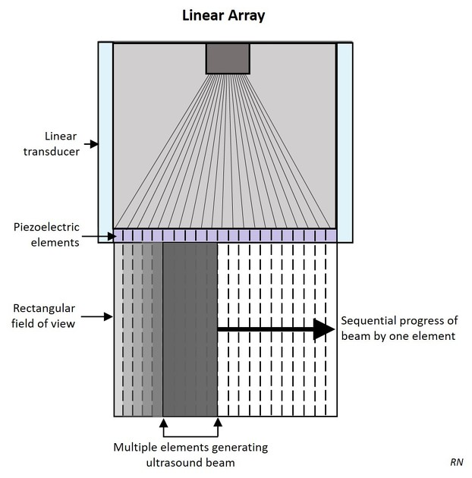
Lecture
SLIDE 6 / 10
Limitations of Array Queues
1
Array queues suffer from the 'False Overflow' problem in linear implementations.
2
Elements shift towards the front, leaving unused space at the beginning.
3
The queue appears full even when significant memory space remains available.
4
A simple linear array cannot reuse the empty space at the start.
5
Circular array implementation is required to solve the false overflow issue.
Source: prod-images-static.radiopaedia.org
Chandigarh University
6 / 10
Notes:
Consider a scenario where we have a queue of size 5. After several enqueues and dequeues, the front pointer moves to index 3. Even if indices 0, 1, and 2 are empty, we cannot add new elements if the rear is at the end. This is called false overflow because the array is technically full despite having free space.

Slide 7
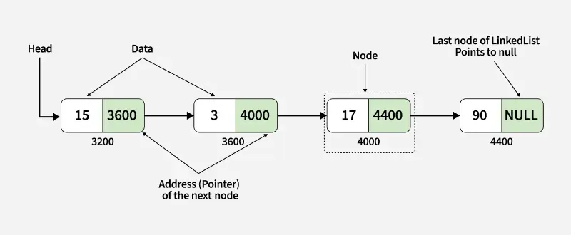
Lecture
SLIDE 7 / 10
Linked List Queue Implementation
1
A linked list queue uses nodes connected by pointers to store data dynamically.
2
Each node contains data and a pointer to the next node in sequence.
3
The 'front' pointer points to the first node for dequeue operations.
4
The 'rear' pointer points to the last node for enqueue operations.
5
Memory is allocated only when a new element is added to the queue.
Source: media.geeksforgeeks.org
Chandigarh University
7 / 10
Notes:
Unlike arrays, linked lists do not require contiguous memory blocks. Each element is a separate node that points to the next one. We maintain two pointers, front and rear, to efficiently add and remove elements. This structure allows the queue to grow and shrink dynamically based on demand.

Slide 8
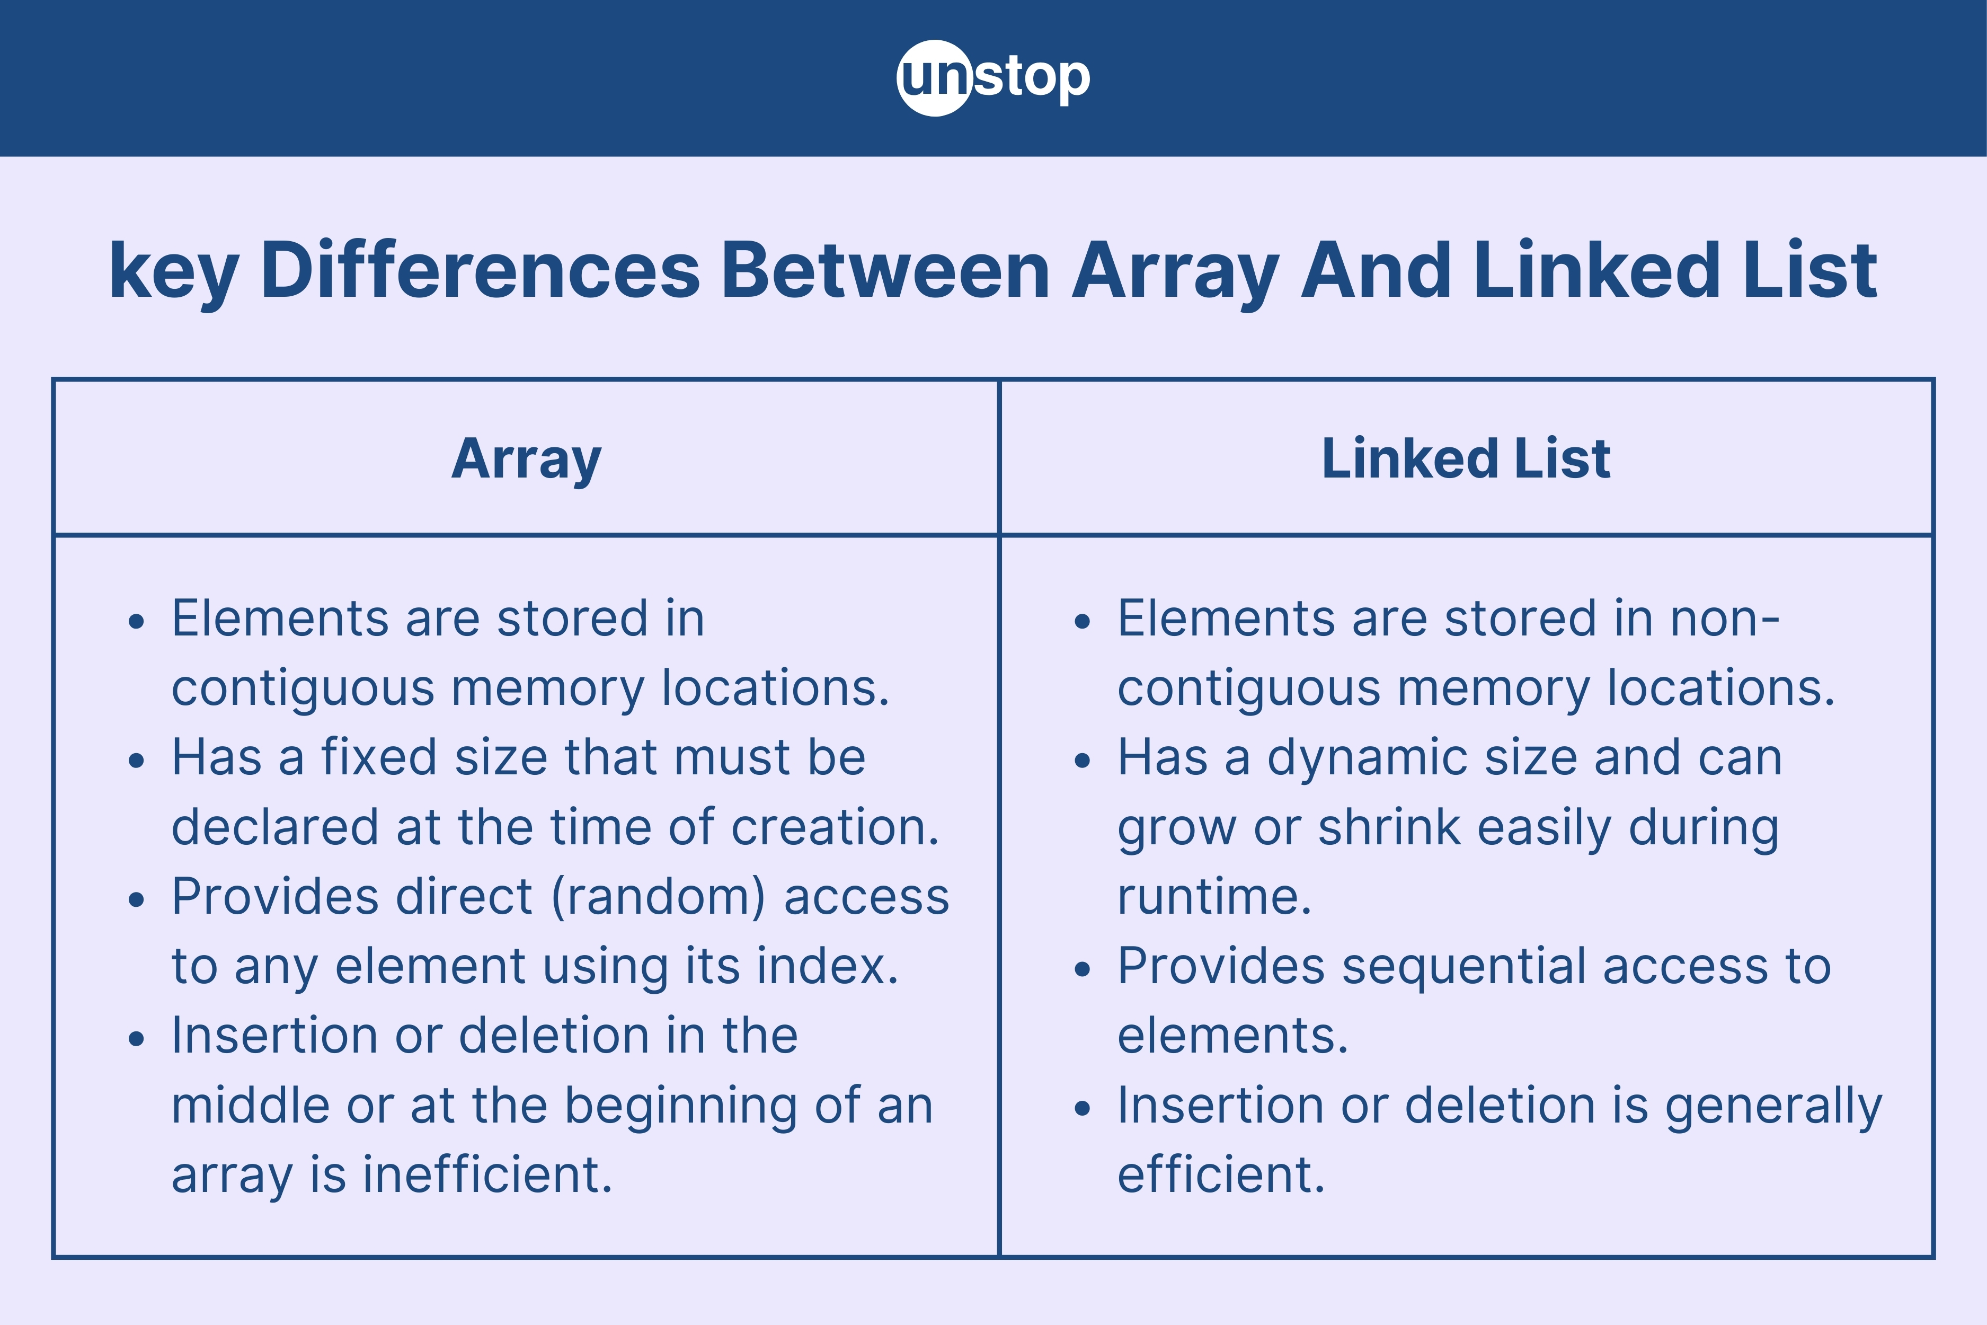
Comparison
SLIDE 8 / 10
Array vs Linked List
1
Arrays have fixed size, while linked lists have dynamic size capabilities.
2
Array access is faster due to contiguous memory allocation.
3
Linked lists require extra memory for storing node pointers.
4
Arrays risk overflow without circular implementation, linked lists do not.
5
Linked lists are preferred when queue size is unpredictable or large.
Source: d8it4huxumps7.cloudfront.net
Chandigarh University
8 / 10
Notes:
Let's compare the two approaches directly. Arrays are faster for access but rigid in size. Linked lists are flexible but use more memory for pointers. If you know the maximum queue size, an array is efficient. If the size varies wildly, a linked list is the safer choice to avoid overflow errors.

Slide 9

Lecture
SLIDE 9 / 10
Key Takeaways
1
Queues operate on the First-In-First-Out (FIFO) principle strictly.
2
Array queues are simple but suffer from false overflow without circular logic.
3
Linked list queues offer dynamic memory allocation and no fixed size limit.
4
Both implementations require managing front and rear pointers efficiently.
5
Choice between array and linked list depends on memory constraints and usage patterns.
Source: ecdn.teacherspayteachers.com
Chandigarh University
9 / 10
Notes:
To summarize, remember that queues are FIFO structures. Arrays are fast but limited by size, often requiring circular logic to be useful. Linked lists solve the size issue but use more memory. Always choose the implementation that best fits your specific application's memory and performance needs.

Slide 10
Lecture
SLIDE 10 / 10
References
DATA STRUCTURES
A Pseudocode Approach with C — Gilberg, Forouzan
• Data Structures — Lipschutz
• Data Structure Using C — AK Sharma
• C and Data structure — P. S. Deshpandey
Chandigarh University
10 / 10
Notes:
For further reading, please refer to the standard textbooks listed here. Gilberg and Forouzan provide excellent pseudocode approaches. Lipschutz offers a comprehensive theoretical foundation. Sharma and Deshpandey provide practical C implementations. These resources will help you deepen your understanding of these data structures.

